Slide 1

Location Based Market Analysis to Identify Optimal Business Location in Colombo District and Suburbs
Shazly Shanawaz

Slide 2
Selecting the optimal location is essential for businesses
The business gains many opportunities when placed in a location withing close proximity of the target audience
Provides a competitive advantage and business value
Enables the business to easily reach out to current and potential customers
Helps manage logistics efficiently and reduce operational costs

Slide 3
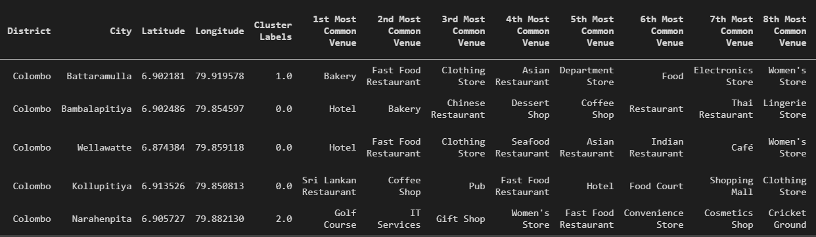
Data collection and preprocessing
Initial data collected from Wikipedia page containing postal codes of Sri Lanka
The coordinates of the neighborhoods would be extracted using the GeoPy Python package
The venue details for the coordinates was extracted using the Foursquare API
The frequency of the venue category was used to find out the most common venues for the model

Slide 4
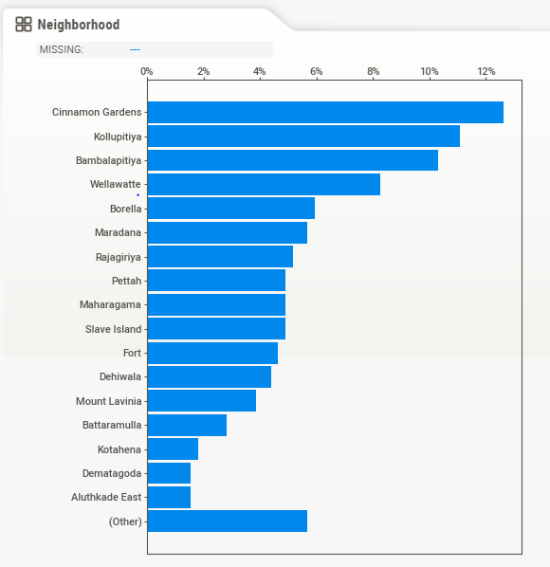
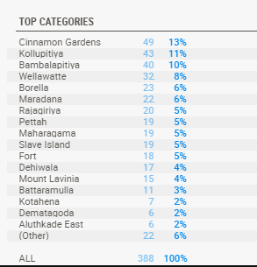
Understanding the distribution of venue data for each of the neighborhood
The visualizations provides insight to the distribution of the entire venue dataset into each neighborhood

Slide 5
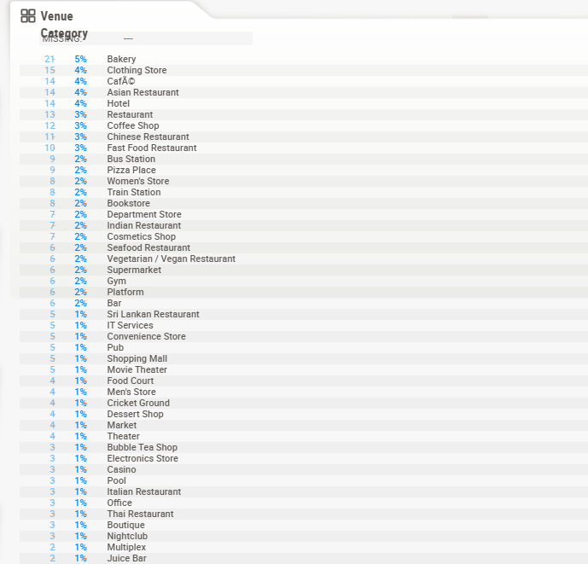
Understanding the distribution of the venue category in the dataset
The visualizations provides insight to the most common venues in each neighborhood
Also, it was identified that a considerable portion of the venue categories was labelled under “Other” which could include many types of businesses not defined in the category list.

Slide 6
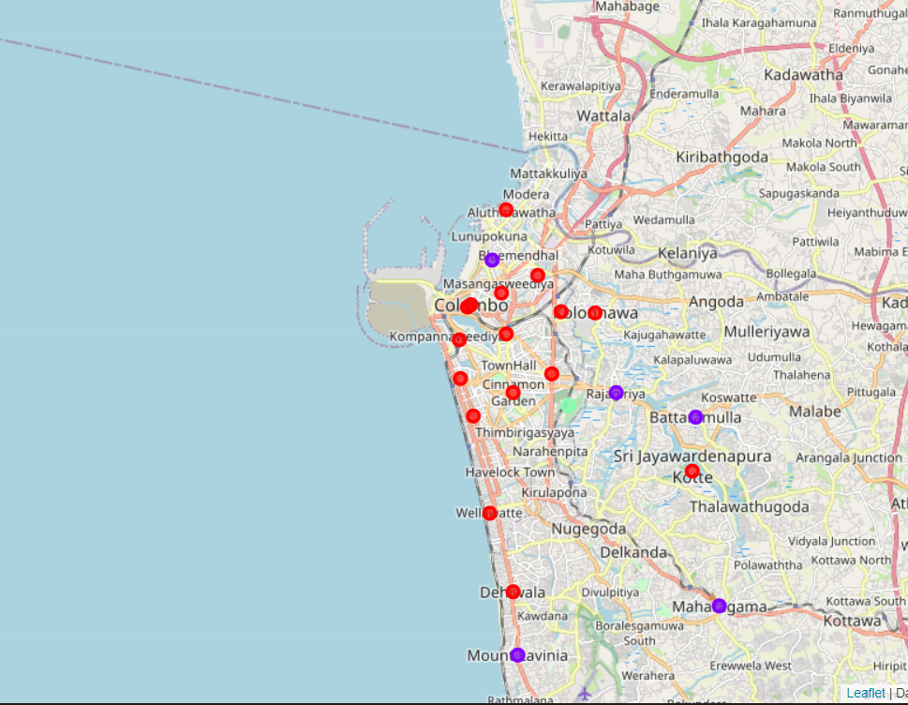
K- Means Clustering Model result
The following cluster result was obtained from the K – Means clustering model and was visualized using Folium

Slide 7
Cluster Segmentation
The first cluster consists of the consumer target market with almost all businesses targeted at residential consumers, with the most common venues being restaurants, coffee shops, supermarkets, consumer stores and other recreational venues for customers. This cluster group is best suited for businesses looking to sell their end product or services to everyday consumers.
The second cluster consists of a combination of consumer market and business market with restaurants, super markets and also IT companies, electronic stores and other service companies, with a mix of businesses which cater to consumers and also businesses which cater to business users and industries. These neighborhoods are optimal if the business looks to sell its products or services to both target markets
The third cluster consists of the business and industrial target market where most of the businesses cater towards other businesses or industries, and have relatively a smaller number of consumer-focused businesses compared to the other clusters

